Slide 1
Welcome To The Neighborhood:
Health Care Access for African New Mainers
American Public Health Association
Annual Meeting, Atlanta
November 6, 2017
Patricia Hart, MS, CPH, Vice President Evaluation, Market Decisions Research
Lindsay Gannon, MPA, Evaluation Associate, Market Decisions Research
Holly Lasagna, MLS, Program Manager, Healthy Androscoggin

Slide 2
Presenter Disclosures Patricia Hart The following personal financial relationships with commercial interests relevant to this presentation existed during the past 12 months: Consultancy
Funded through a Cooperative Agreement Number U58DP005793, funded by the U. S. Centers for Disease Control and Prevention,
Racial and Ethnic Approaches to Community Health (REACH) Grant.

Slide 3
Lewiston-Auburn Maine
Twin cities in central Maine, combined population 59,647.
Long history of French-Canadian immigration. Recent growth from African Countries.
11.2% of population are non-white “New Mainers.”
Limited experience in serving the rapidly diversifying population.

Slide 4
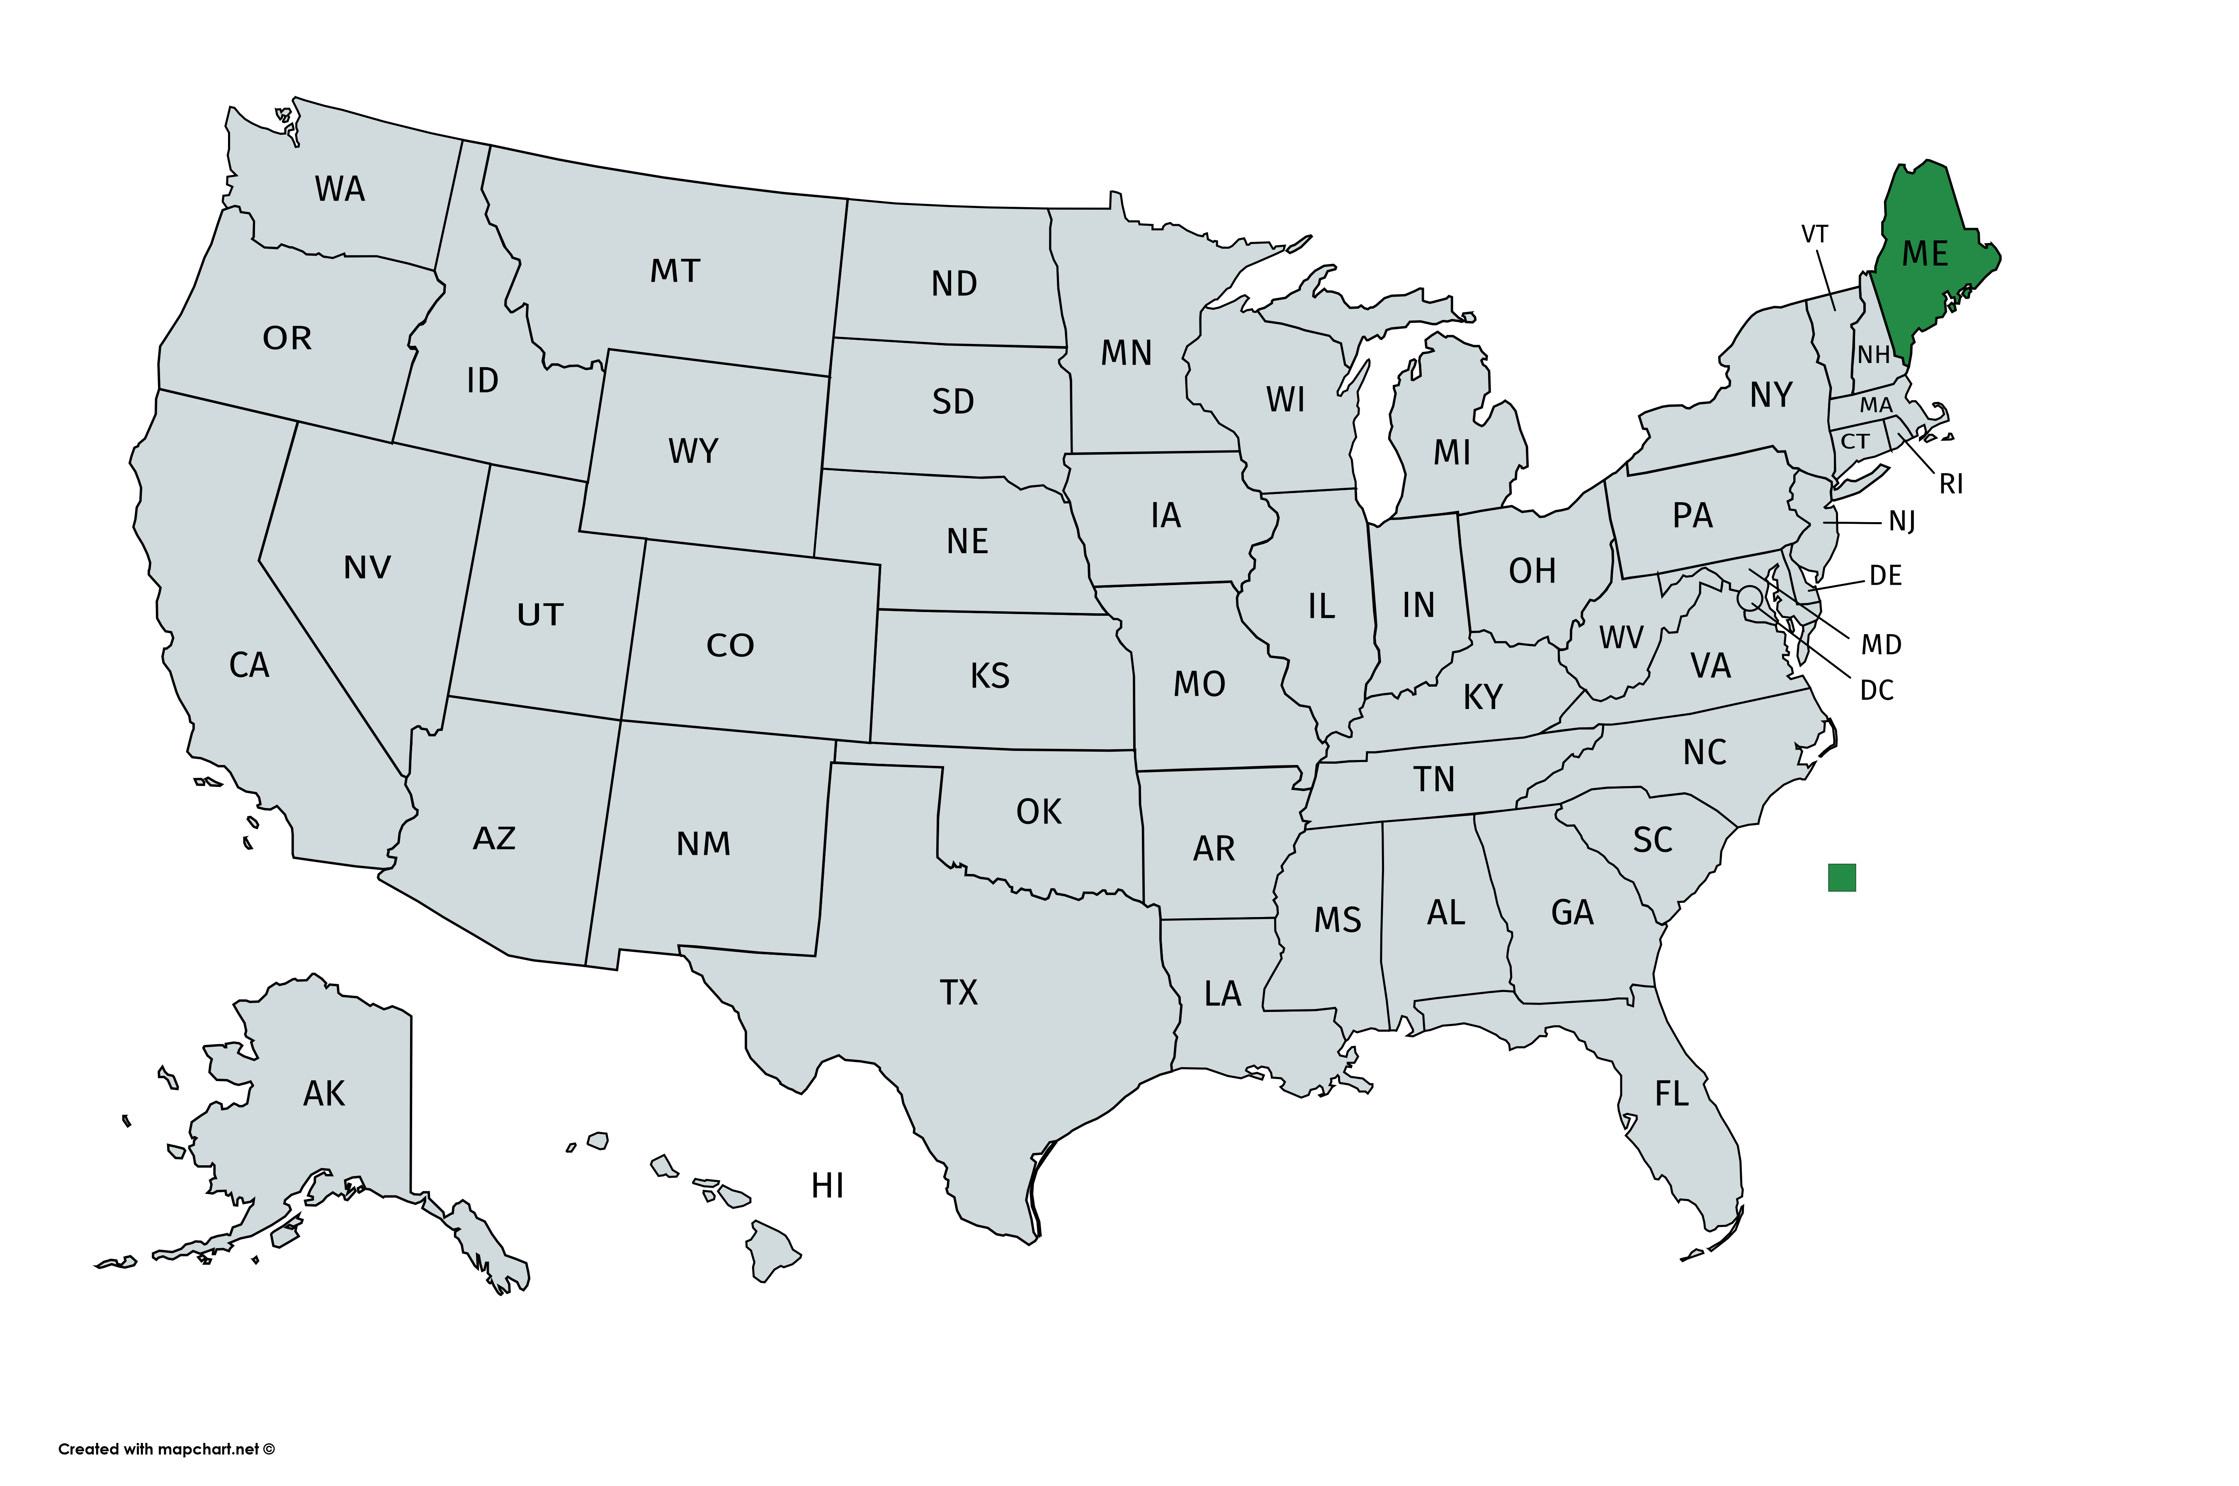
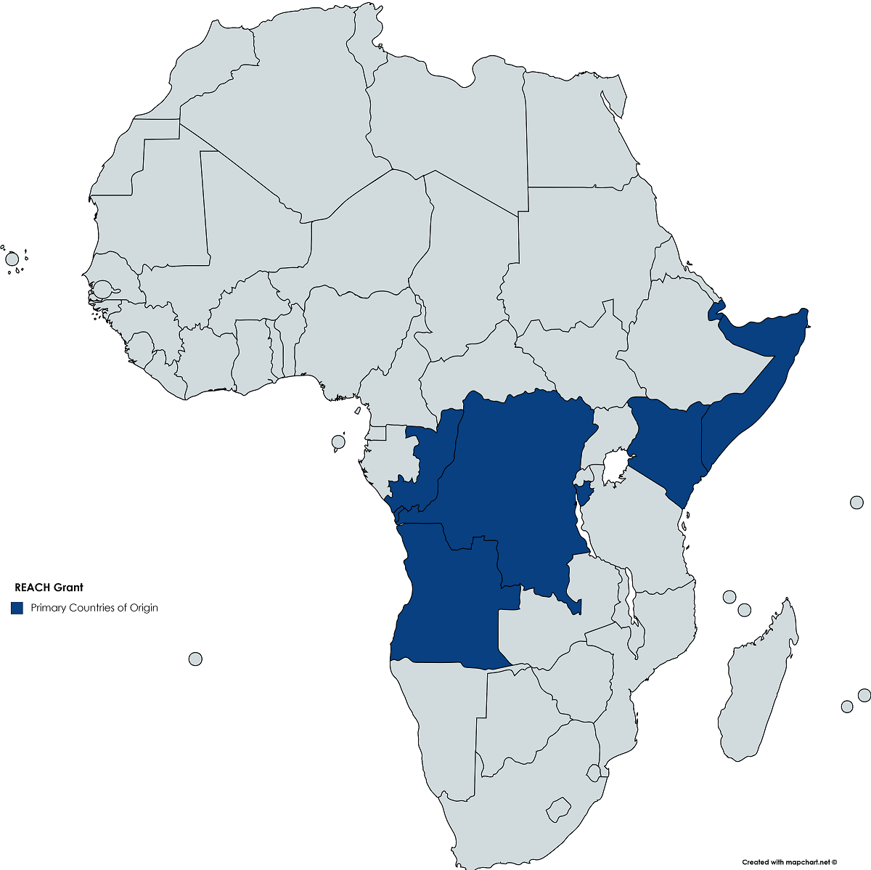
Background
In 2014, Healthy Androscoggin received a 3-year Racial and Ethnic Approaches to Community Health (REACH) grant from the US CDC.
Improve cultural competency and increase access to care.
Training, data collection, resources, and materials to 8 mainstream health and wellness partners.
Somalia, Djibouti, Burundi, Kenya, Angola, Democratic Republic of the Congo.
Primary languages - Somali, Arabic, French, Portuguese.

Slide 5
Cultural Competency & Implicit Bias
Cultural Competency
Understanding who you are and how that can help you understand others.
Learned and shared values, attitudes, beliefs, and behaviors.
Implicit Bias
Mental associations that are so well-established without awareness, intention, or control.
Activated quickly and unknowingly by situational cues (e.g., a person's skin color or accent or other characteristic.)
Notes:
Why does this matter?
Pain levels estimated as lower for black patients, thus less pain medication prescribed for same conditions as whites.
Healthcare workers more likely to believe black patients will not adhere to treatment recommendations than their white peers.
Black and Hispanic patients far less likely to be counseled about smoking cessation than whites.
Relative to white men, white women were 72% as likely to receive a recommended invasive cardiac procedure, black men 67%, and black women 50%.

Slide 6
Patient-Provider Relationship Stereotypes and Effects
Stereotypes |  |  | Type of Discrimination
 | Low Competence/Status | High Competence/Status
High Warmth/ Cooperation | Irish immigrants, Italian immigrants, older people, disabled people, effeminate gay men, housewives (pity, sympathy) | Middle-class Whites, Christians, heterosexuals, Canadian immigrants, third-generation immigrants, closeted gay men (pride, admiration) | Active Help/ Protect
Low Warmth/ Cooperation | Poor Blacks, undocumented immigrants, Latinos, poor Whites, homeless people, drug addicts, rough-trade gay men (disgust, contempt) | Black professionals, Asian immigrants, Jewish Americans, outsider entrepreneurs, lesbians, professional women, gay male professionals (envy, jealousy) | Active Harm/ Attack
 | Passive Harm/Neglect | Passive Help/Association
Dovidio, J. F., & Fiske, S. T. (2012). Under the Radar: How Unexamined Biases in Decision-Making Processes in Clinical Interactions Can Contribute to Health Care Disparities. American Journal of Public Health, 102(5), 945-952
Notes:
One study showed physicians in Pennsylvania exhibited fewer positive, rapport-building nonverbal cues to their non-white patients.
Healthcare worker bias is often noted as a factor in delayed screening and disparities in follow-up and treatment between black and white patients.
Only 48% of Asian Americans and 47% of African Americans believe that their health care provider understands their background and values.

Slide 8
CLAS Standards References
15 National Culturally and Linguistically Appropriate Services (CLAS) Standards.
The National CLAS Standards are intended to advance health equity,
improve quality, and help eliminate health care disparities by
establishing a blueprint for health and health care organizations.
A Blueprint for Advancing and Sustaining CLAS Policy and Practice
https://www.thinkculturalhealth.hhs.gov/clas/blueprint.

Slide 9
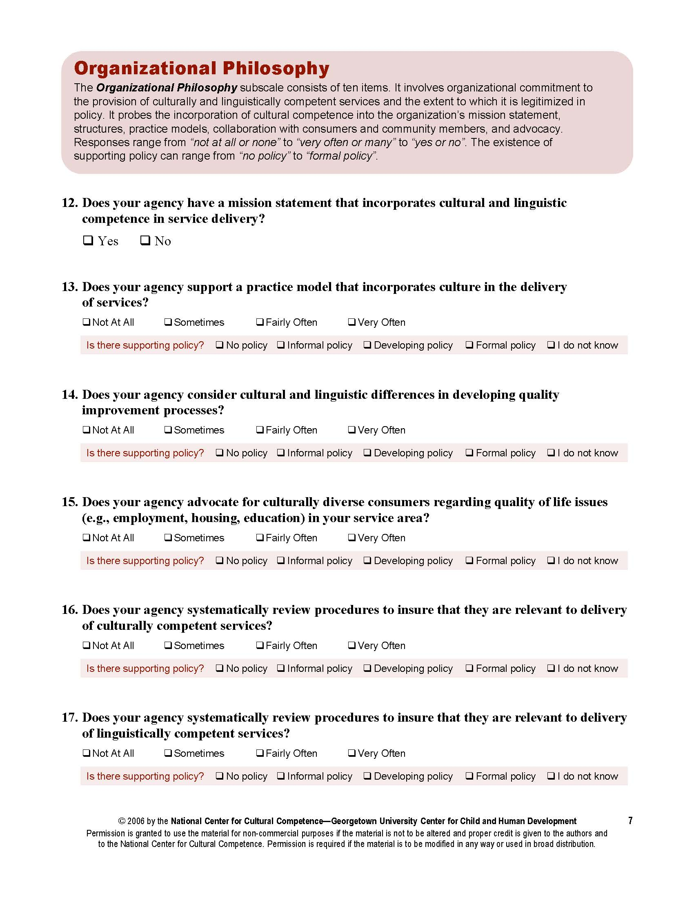
CLAS Assessment
The Cultural and Linguistic Competence Policy Assessment (CLCPA) was developed by the National Center for Cultural Competence at Georgetown University.
Permission to use was required and granted.

Slide 10
CLAS Self-Assessment Process
Research CLAS standards & select assessment tool
Meet with each partner to review tool and provide technical assistance
Partner completes baseline assessment
Assessments are scored, baseline reports disseminated
Goals and action plans created with each partner
Strategies are implemented - training and resources provided
Post assessment completed & CLAS outcomes reported

Slide 11
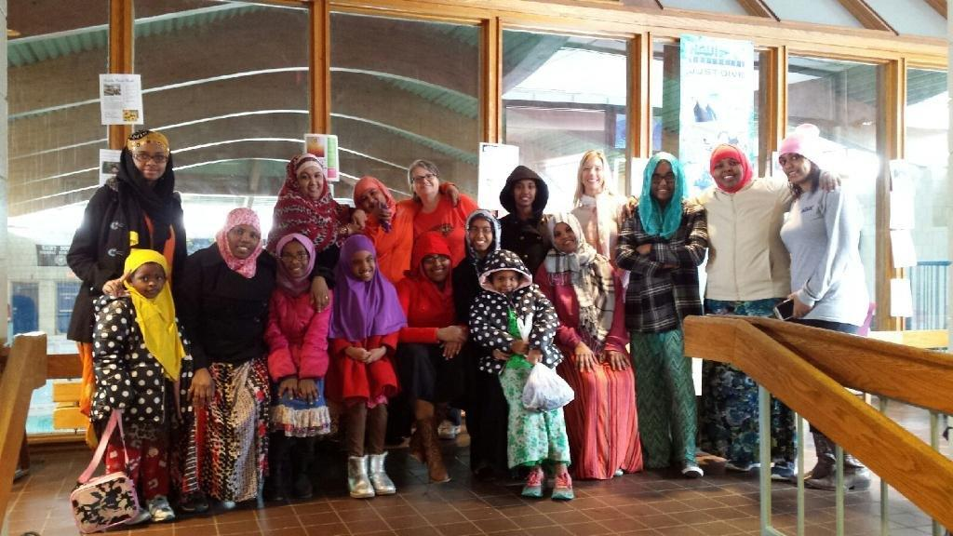
Action Plan Example: YWCA of Central Maine
Reviewing and Building on Strengths
The organization has a strong focus on respectful delivery of services to all cultures and races in the community. This includes having a staff position focused on social justice and advocacy.
Reviewing Opportunities for Improvement
Create welcoming décor, a translated membership form, and information about use of the facilities.
Top Goal
Develop video about use of swim facilities
for African New Mainer women.
Strategies and Resources to Achieve Goal
Work with media production company and REACH staff to
develop video that focuses on facilities use for African New Mainers.

Slide 12
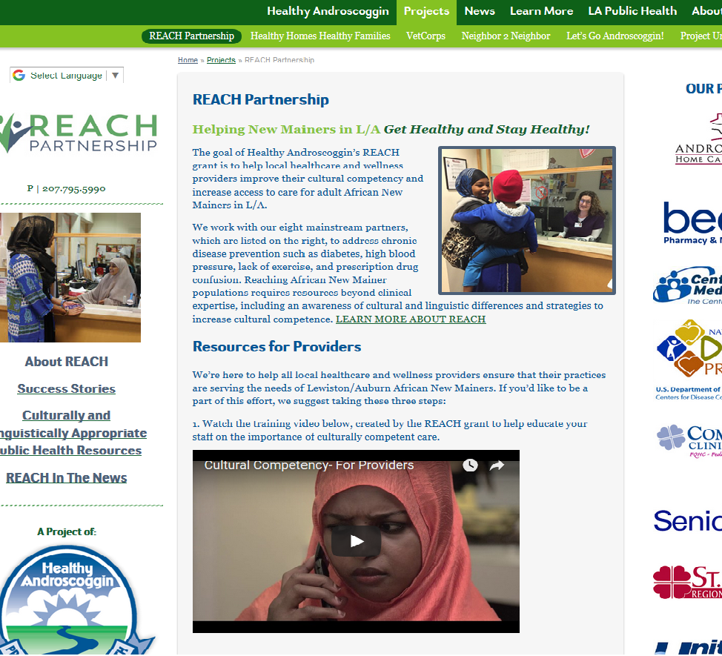
Implementation Strategies
Training
Onsite, agency specific.
Large, open to community sessions.
Invite local ethnic organizations to speak.
Imbed trainings in iCare employee module.
Resources and Materials
Translated documents.
Welcoming décor.
Culture specific resources.
REACH landing page.
Video Productions
Two training videos.
Two program specific videos.
Offered in multiple languages
Technical Assistance

Slide 13
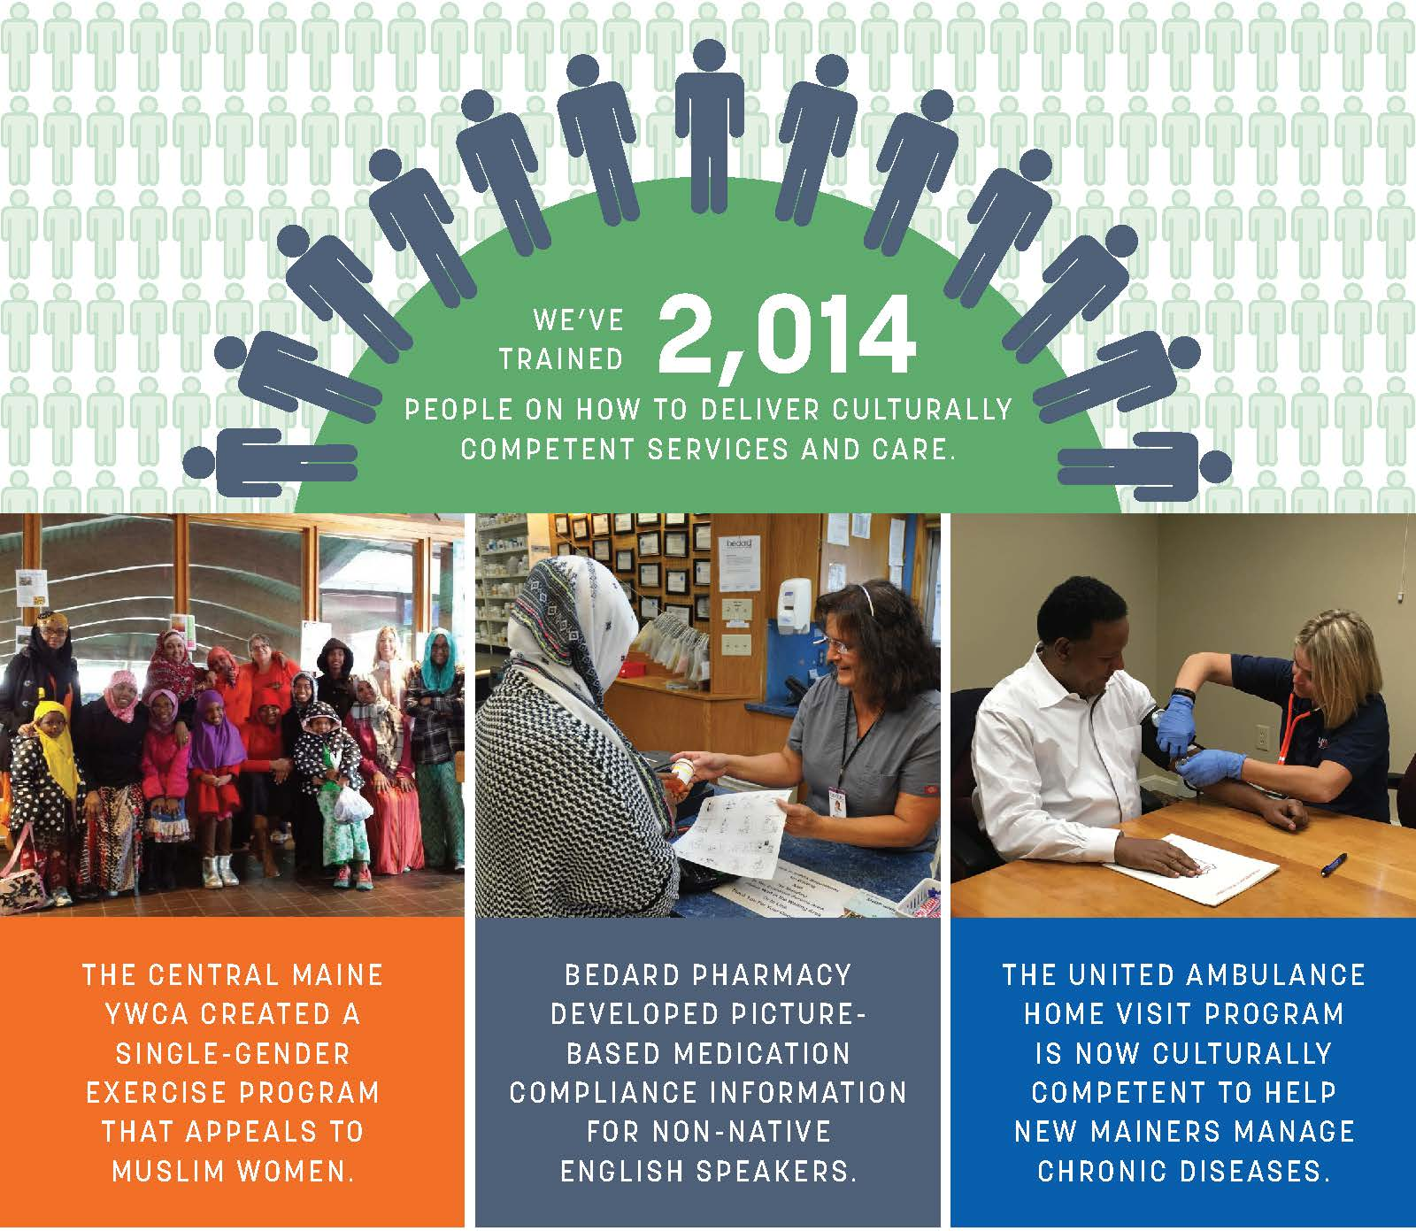
Training Results
Over 2,000 people trained in cultural competency and implicit bias.
Representing 13 agencies in the community.
Now required training for all CMMC hospital employees.
Attendees reported an increase in their ability to provide culturally competent services and that they were able to put their new skills into practice.
“This was the best training I have ever gone through, thank you!”

Slide 14
Assessment Methodology
Mapped 53 assessment questions to the 15 National CLAS Standards.
Created a scoring system to measure REACH partners’ changes in cultural and linguistic organizational competency over a one-year period.
Converted the 4-point scale responses to a 100-point index.
Repeated the measure and scoring after one year.
Not meeting standard
Minimally meeting standard
Partially meeting standard
Mostly meeting standard
0-25 points | 26-50 points | 51-75 points | 76-100 points

Slide 15
CLAS Outcomes
Objective: Each of the 8 REACH Partners will improve in at least 1 CLAS Standard.
Outcome: All 8 of the REACH Partners far exceeded those expectations.
On average, out of the 15 National CLAS Standards, 8 REACH Partners: | Increased scores on 11 Standards Improved ratings on 8 Standards Rated “Partially or Mostly Meeting” on 9 Standards

Slide 16
TOP 5 Improved Standards
1 | Standard 11 Collect and maintain accurate and reliable demographic data to monitor and evaluate the impact of CLAS on health equity and outcomes and to inform service delivery.
2 | Standard 8 Provide easy-to-understand print and multimedia materials and signage in the languages commonly used by the populations in the service area.
3 | Standard 5 Offer language assistance to individuals who have limited English proficiency and/or other communication needs, at no cost to them, to facilitate timely access to all health care and services.
4 | Standard 7 Ensure the competence of individuals providing language assistance, recognizing that the use of untrained individuals and/or minors as interpreters should be avoided.
5 | Standard 1 (Principal Standard) Provide effective, equitable, understandable, and respectful quality care and services that are responsive to diverse cultural health beliefs and practices, preferred languages, health literacy, and other communication needs.
Notes:
These match the goals that were selected!

Slide 18
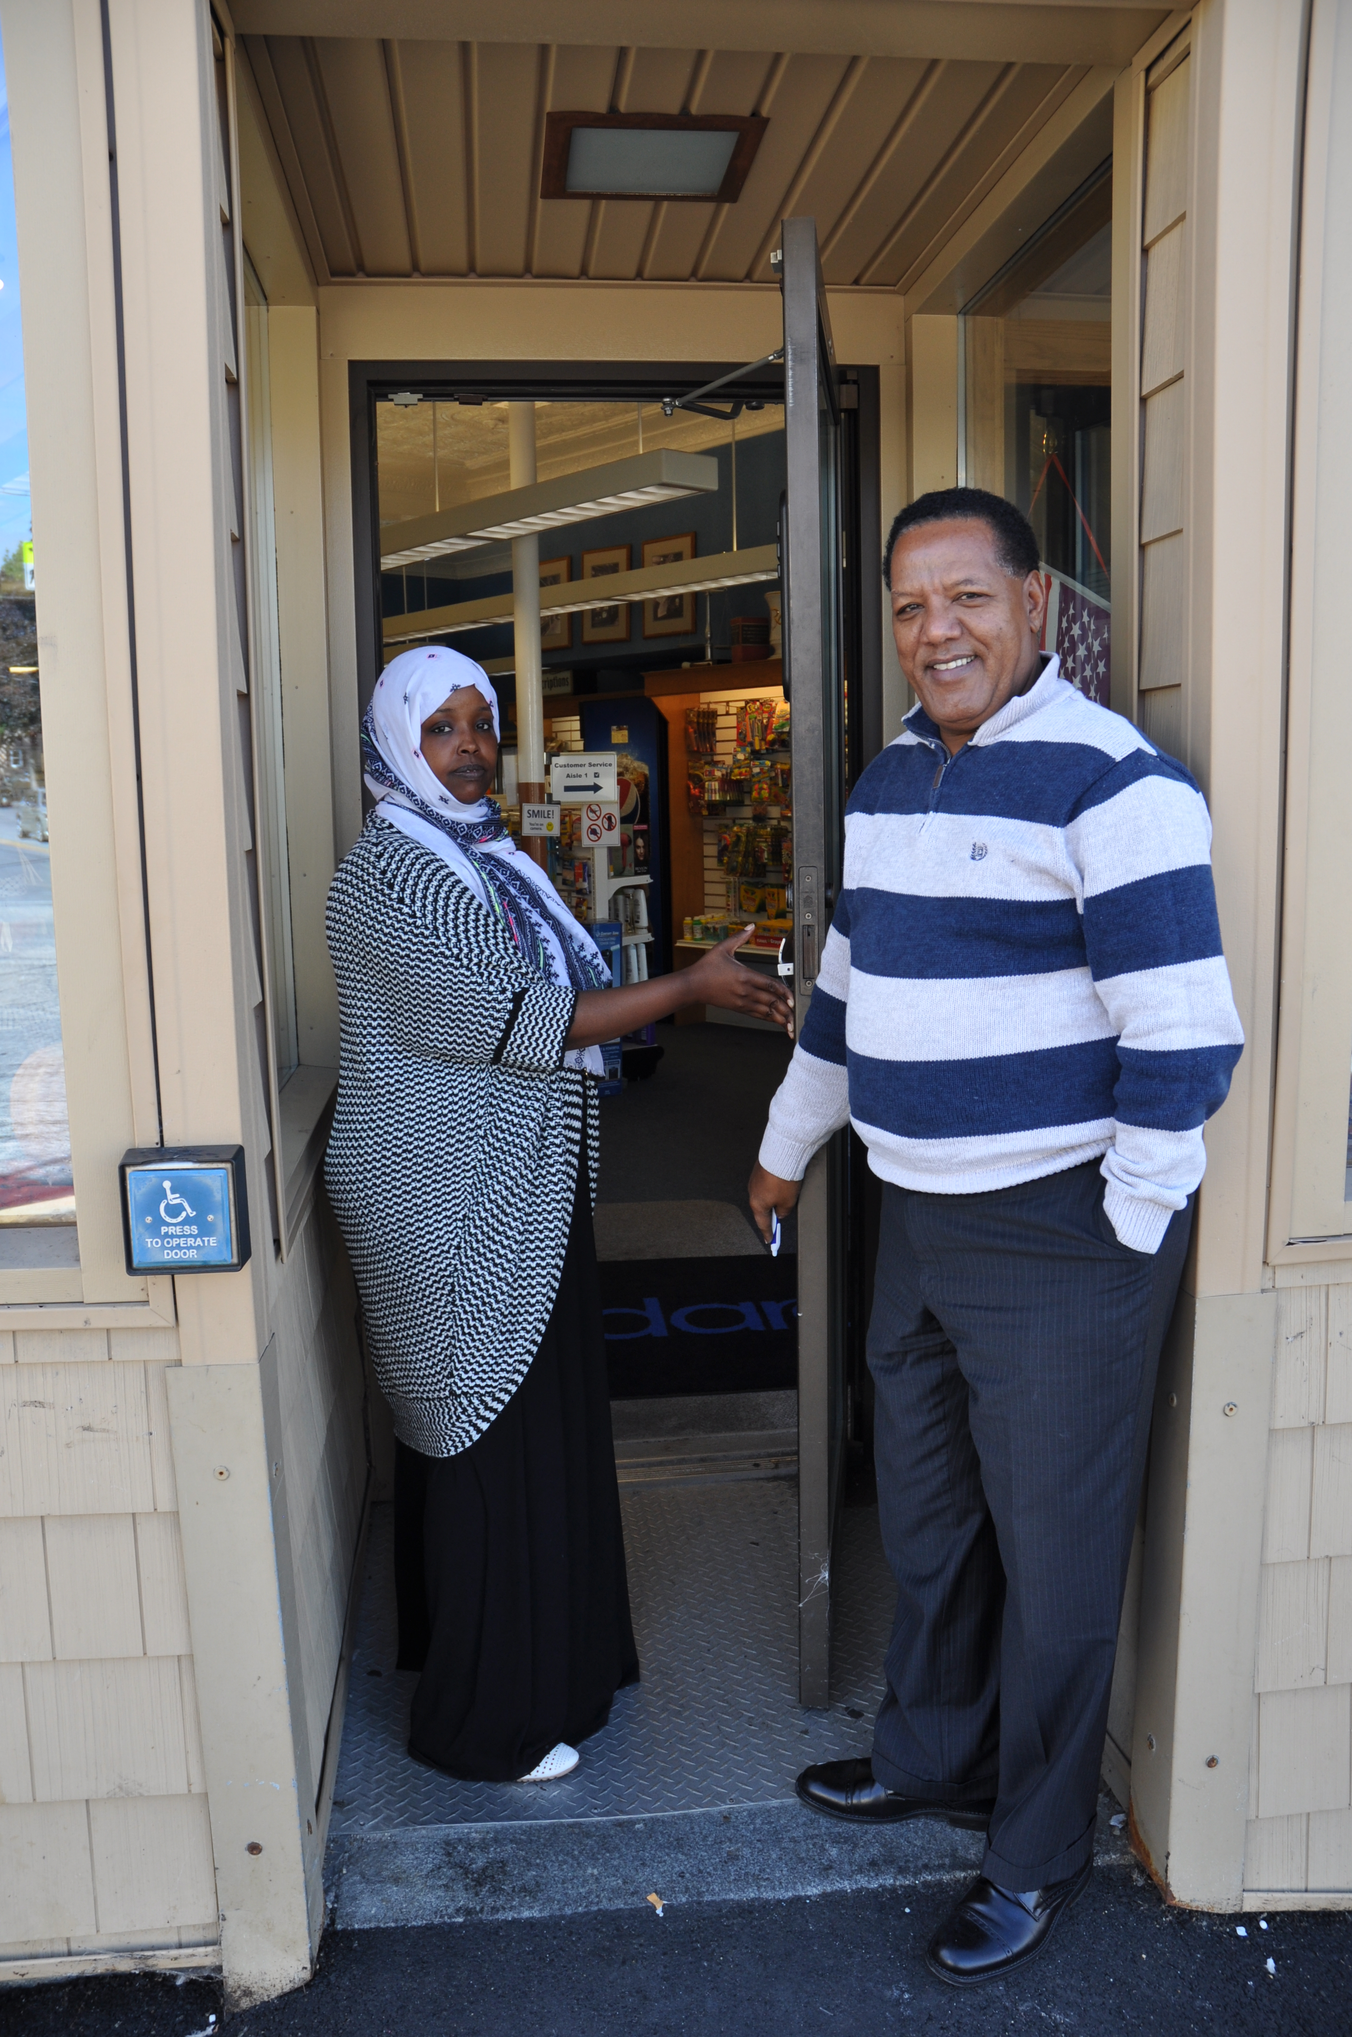
Lessons Learned
Ensure top level and front line staff are involved.
Create task force or workgroup at each agency.
Identify champion.
Find a tool that fits local partner needs.
Recognize the varied nature of each of the standards-some broad, some narrow.
Provide more time before the baseline assessment for agency preparation.
Translating the CLAS standards into strategies made it easier for partners to take action.

Slide 19
Thank you
Pat.Hart@marketdecisions.com
Lgannon@marketdecisions.com
Lasagnho@cmhc.org
www.marketdecisions.com
www.healthyandroscoggin.org/REACH

